Slide 1
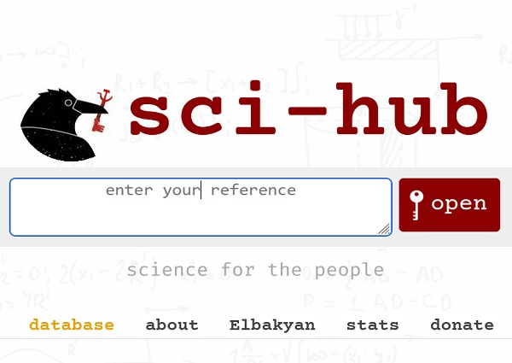


Feature-Based Transfer Learning for Network Security
Paper author:
Dr. Juan Zhao
PhD in Data Science
American Heart Association
Presenter:
Khalid Khader
Birzeit University
Advanced Computer Network course

Slide 2
Introduction
Cyber-attacks are a growing concern in military and commercial networks
Conventional signature-based detection approaches are insufficient
Increased sophistication and variants of attacks pose a challenge
There is a need for intelligent anomaly detection techniques

Slide 3
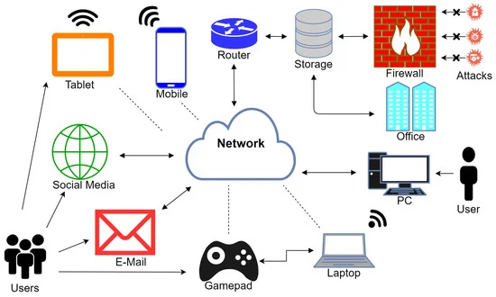
What is a cyberattack?
A cyberattack is any intentional effort to steal, expose, alter, disable, or destroy data, applications or other assets through unauthorized access to a network, computer system or digital device.
What are the common types of cyberattacks?
Cross-site scripting (XSS)
SQL injection
DNS tunneling
Zero-day exploits
Fileless attacks
DNS spoofing

Slide 4
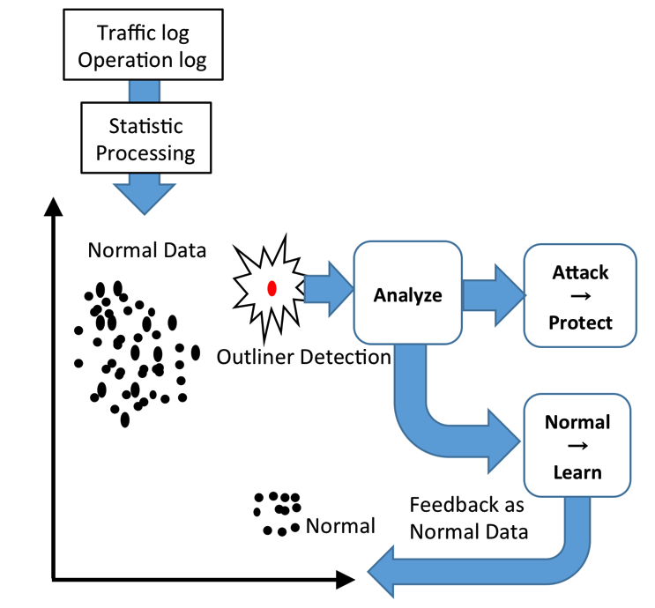
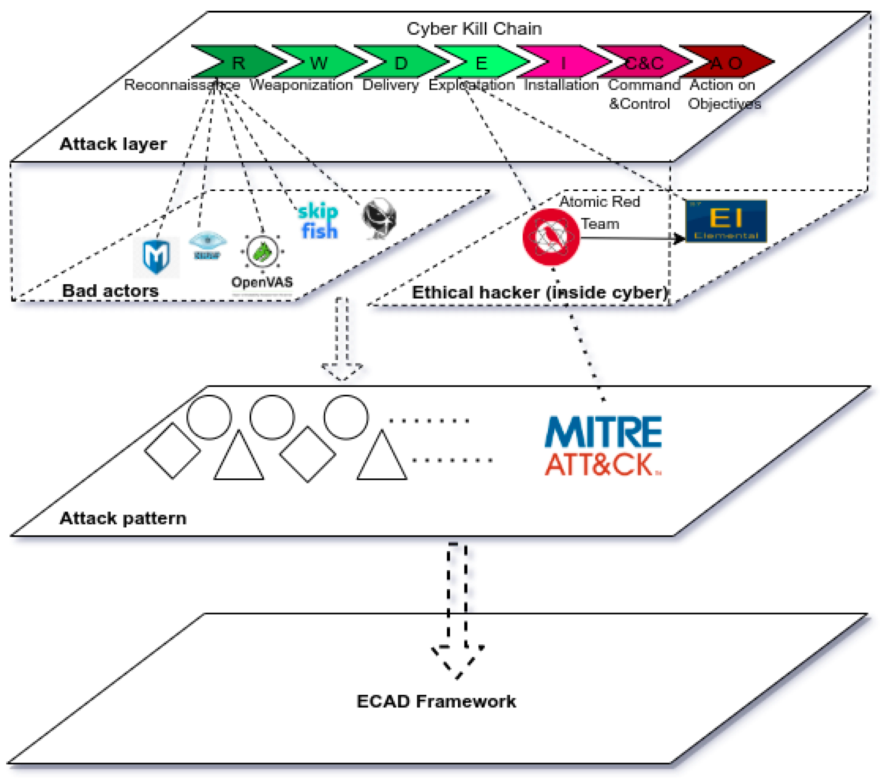
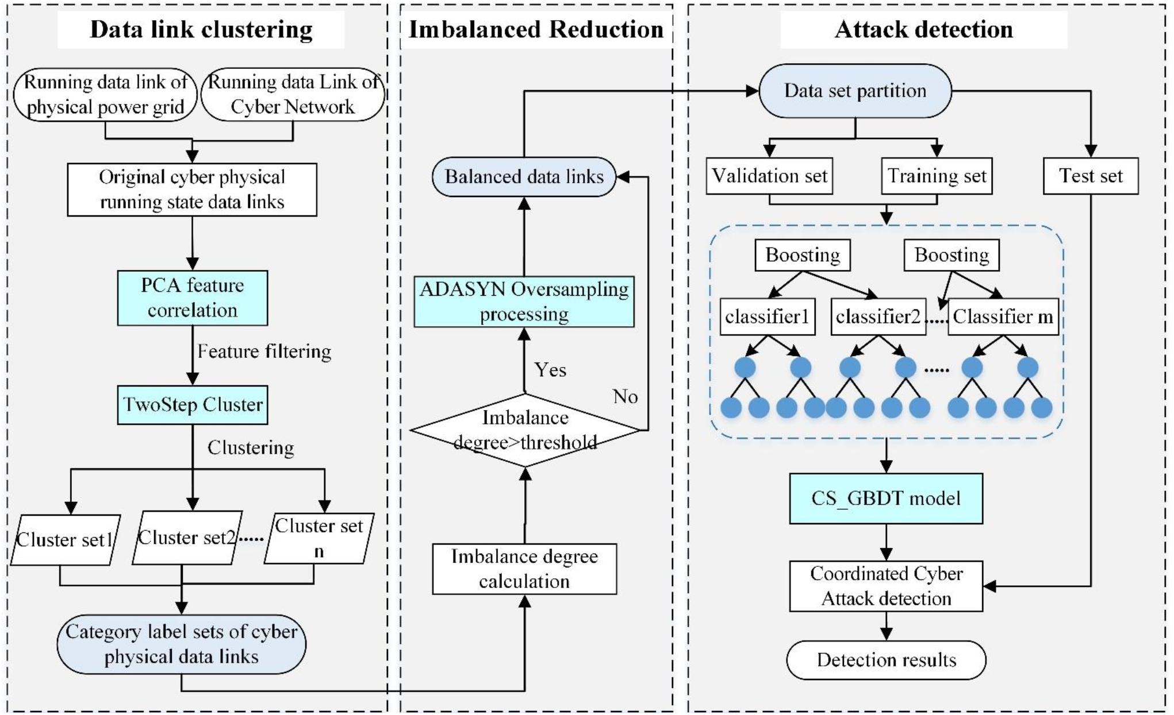
What is a cyberattack?

Slide 5
Traditional Network Security Approaches
Limitations of traditional approaches
Inability to handle evolving threats
Time-consuming process of creating custom models

Slide 6

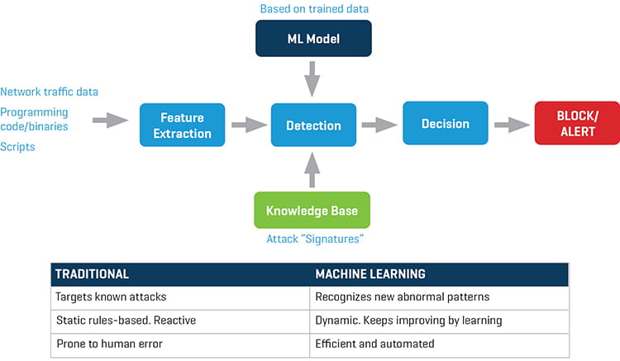
Why ML in cyberattacks?

Slide 7
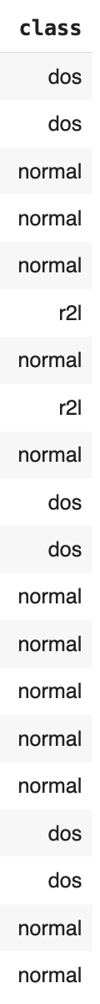
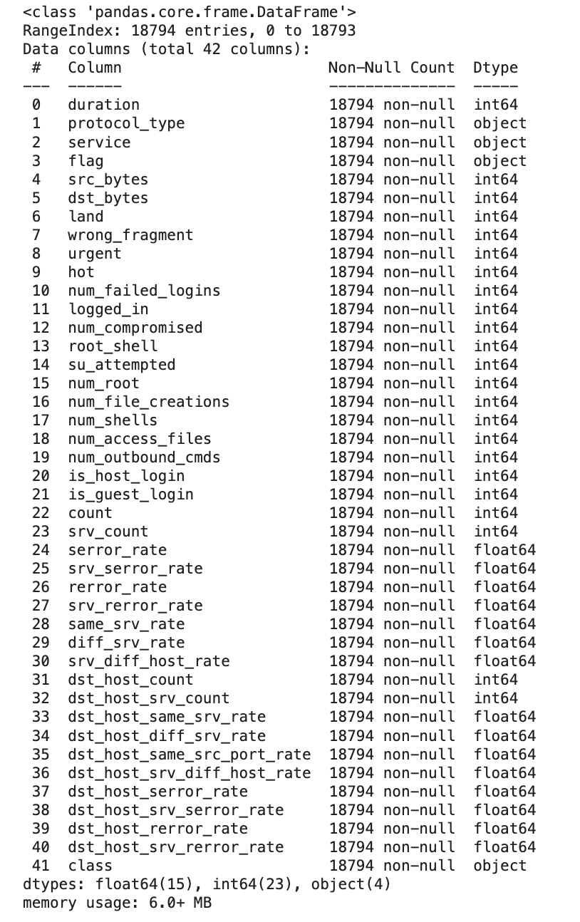
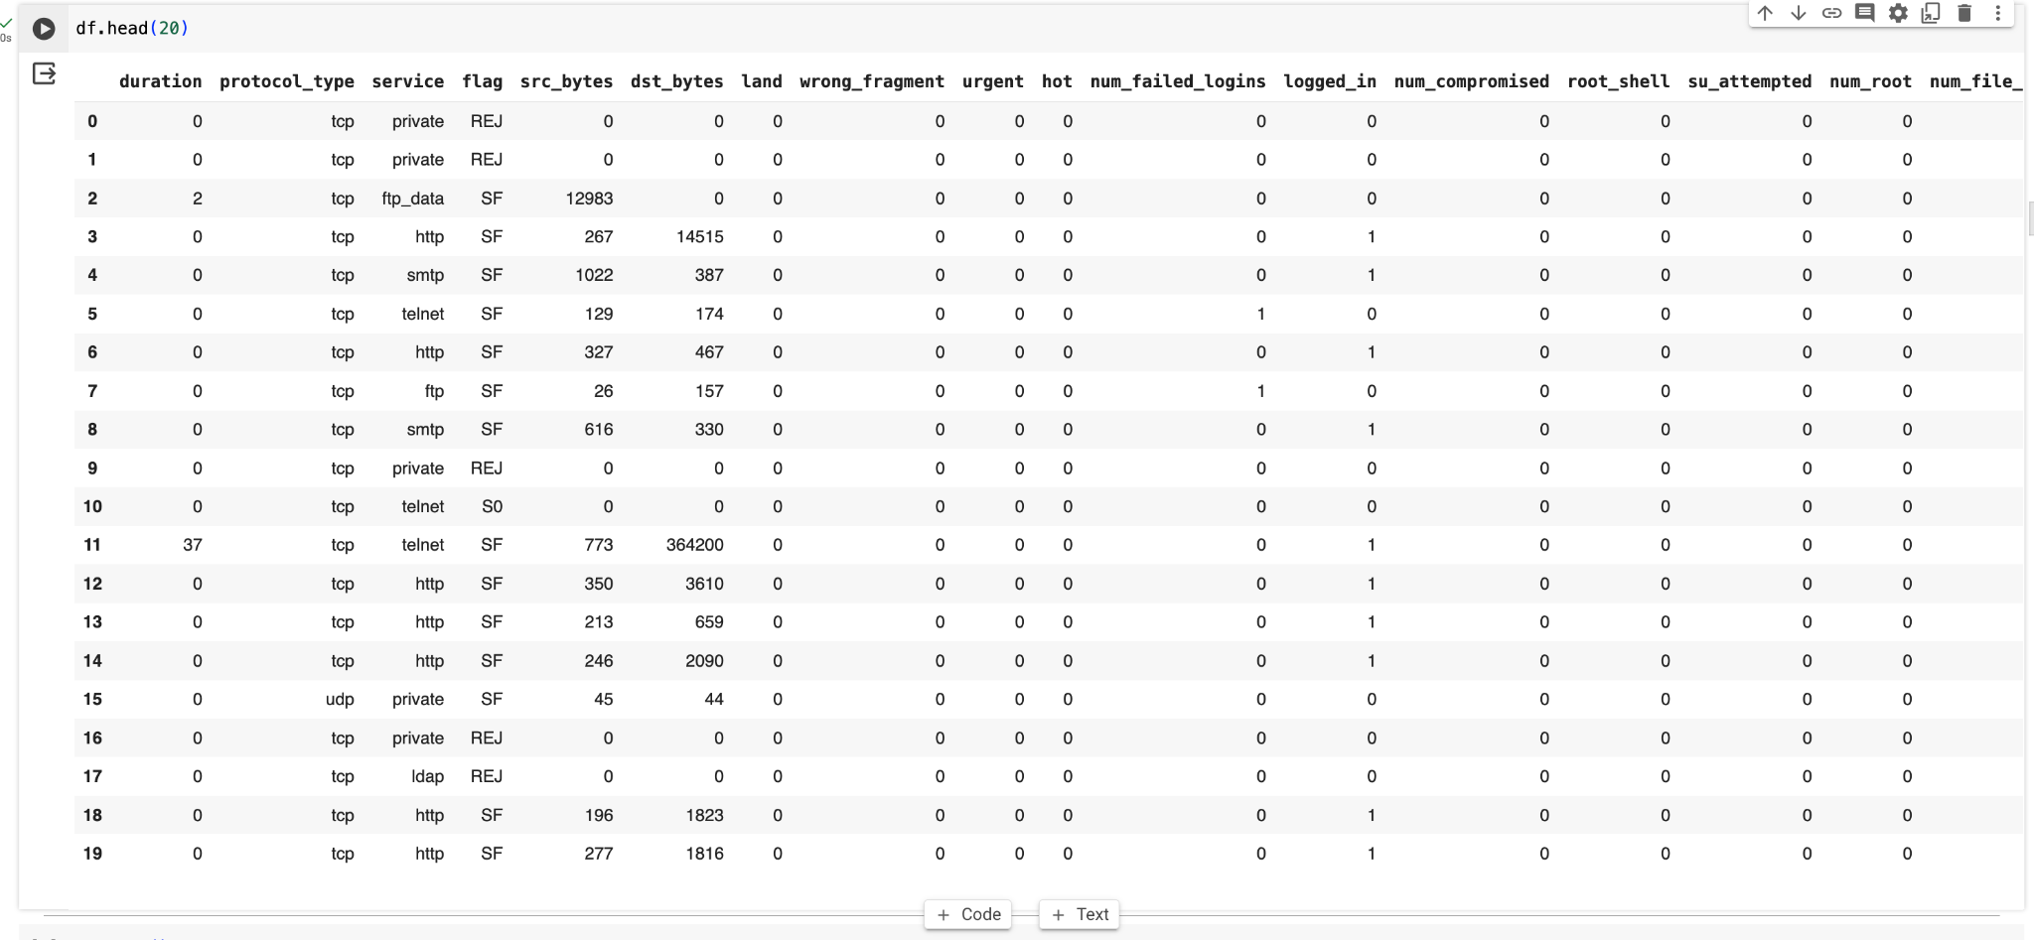
The Task?

Slide 8
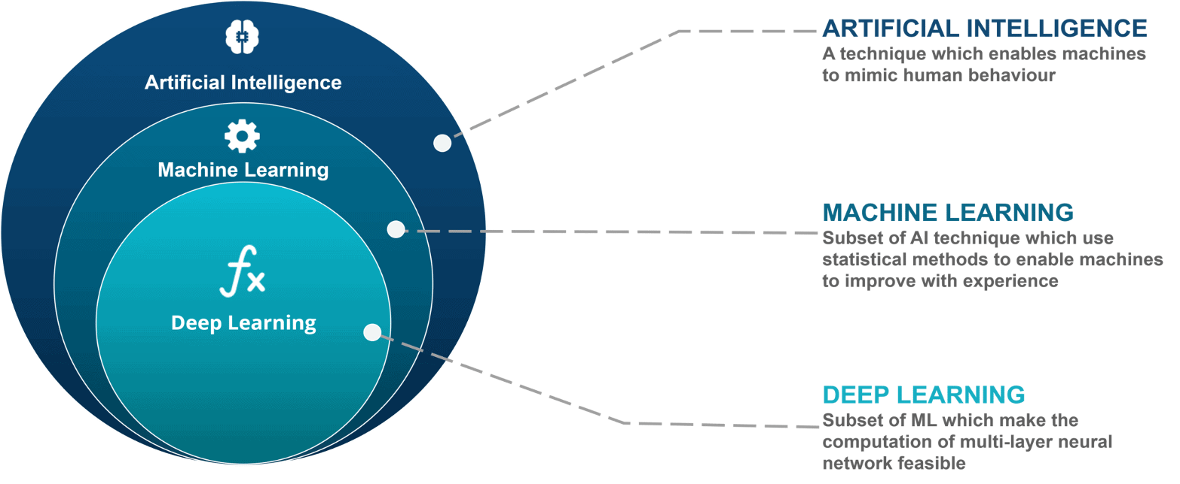
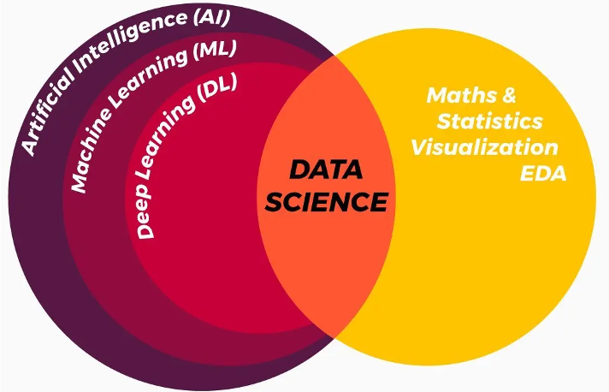

Slide 9
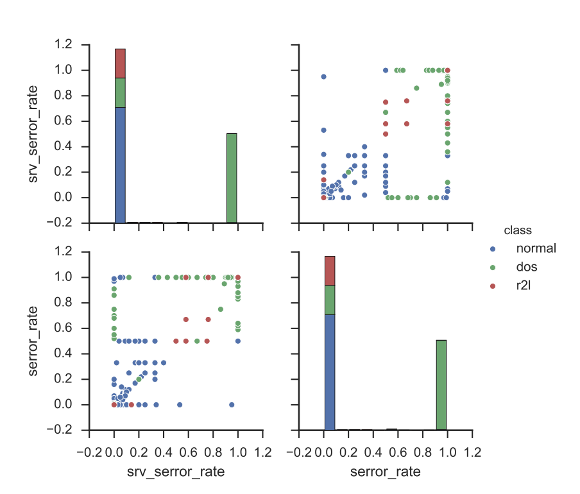
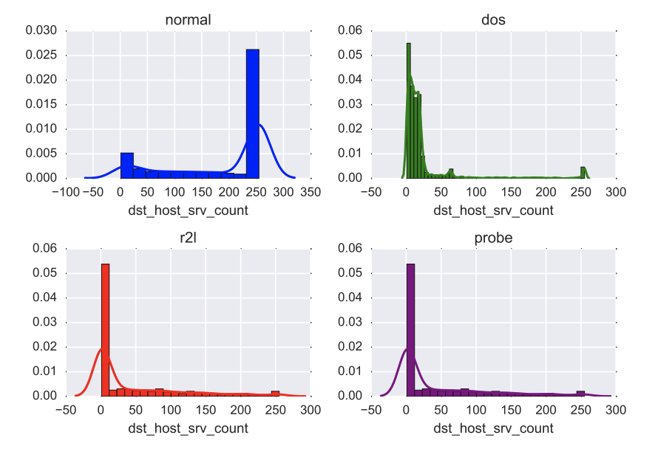
Machine Learning for Detection
Machine learning techniques improve detection rates
Challenges exist in detecting evolving attacks
Unsupervised anomaly detection has lower precision
Data driven supervised classifiers rely on known samples

Slide 10
What is transfer learning?
Is the reuse of a pre-trained model on a new problem.
Involves leveraging a pre-trained model to help build/train another model.
The knowledge from the pre-trained model is "transferred" to the new model.

Slide 11
Transfer Learning
Inspired by human transitive inference and learning
Feature-based transfer learning enhances adaptation and robustness
Transfers learned knowledge from a related domain
Network attacks share common traits and features
Transfer learning techniques provide a good fit

Slide 12
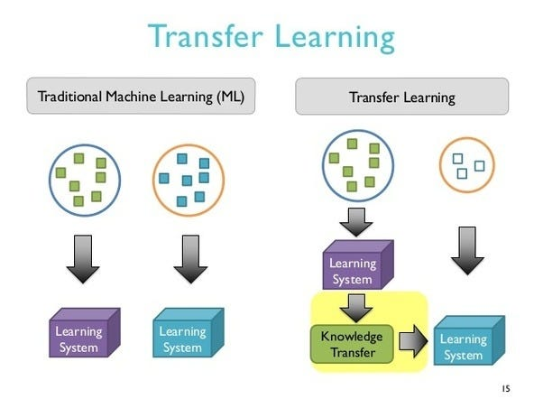
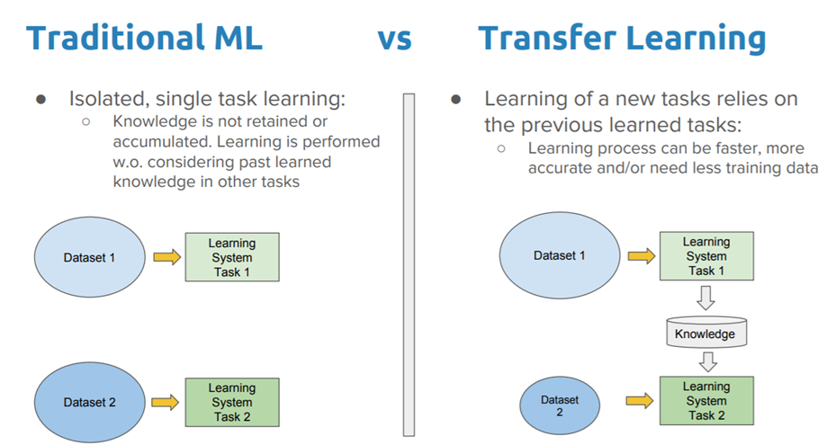
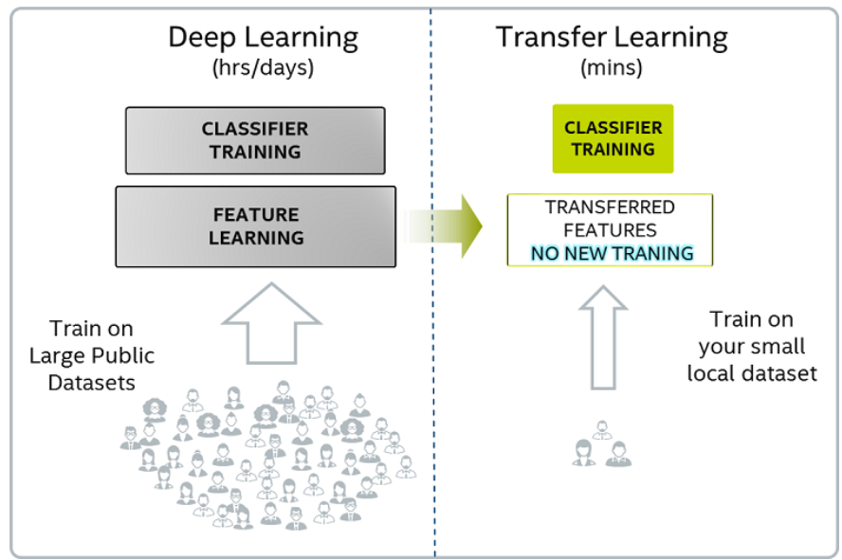
ML vs TL for Detection

Slide 13
HeTL: Feature-based Transfer Learning
Reduce distribution differences and equalize feature space dimensions
HeTL is an improvement on HeMap to implement the framework
Find optimized feature representations from train and test data
Feed optimized representations to supervised learning algorithms
Achieve a more robust classifier for detecting new threats

Slide 14
Contributions of the Work
Comparison with baseline approaches on NSL-KDD dataset
Framework for detecting new attacks using transfer learning
Significantly better performance in detecting new attacks
Evaluation of feature-based transfer learning for network attacks

Slide 15
Applications of Feature-Based Transfer Learning
Strengthening network anomaly detection
Enhancing intrusion detection systems
Improving malware detection
Problem Formulation: Binary Classification
In network attack detection, we frame the problem as a binary classification task.
We have training examples from a source domain (S) with labels (LS) and target domain data (T) without labels.
The feature space and distributions of the source and target data are different, and our objective is to accurately predict the labels for the target data.
Stage 1: Feature Extraction
Stage 2: Feature-based Transfer Learning
Stage 3: Supervised Classification
Extract features from raw network trace data using statistical calculations of network flow.
Learn a new feature representation using feature-based transfer learning algorithms, incorporating both source and target domain data.
Utilize a common base classifier, such as decision trees, random forest trees, SVM, KNN, or Naive Bayes, to classify samples based on the learned representation.

Slide 16
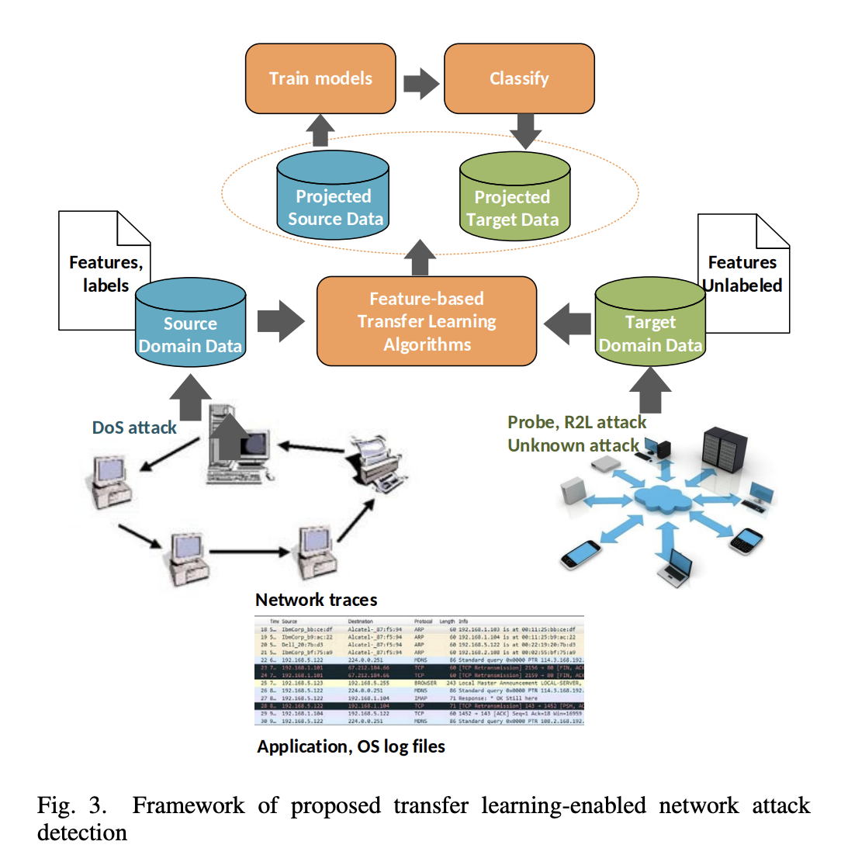
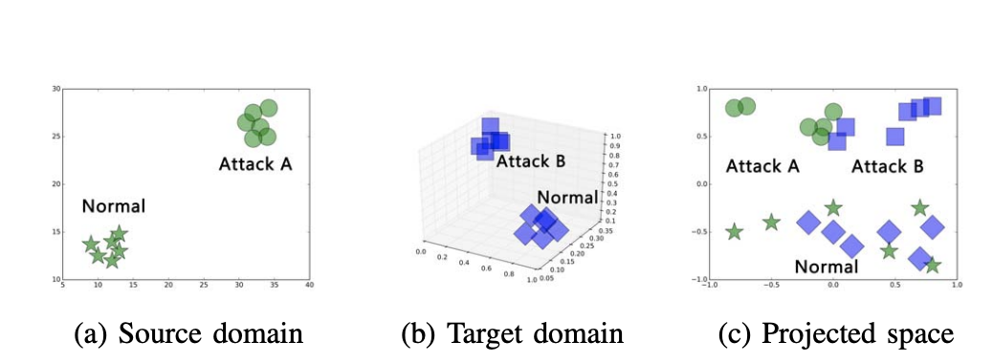
OVERVIEW OF THE TRANSFER LEARNING FRAMEWORK
The framework:
Is flexible and can handle different attack distributions and feature sets between the source and target domains.
Offers a powerful approach to enhance network attack detection and improve overall security.
Leverages transfer learning to improve the detection of new network attacks.
The goal is to use the knowledge from the source domain to effectively detect and classify attacks in the target domain.
Unlike previous approaches, our framework allows for the introduction of new features in the target domain.

Slide 17
Data Set
NSL-KDD Benchmark Dataset
The NSL-KDD benchmark dataset is a collection of extracted features from TCP connection records on a local area network.
The dataset includes 22 different attacks, grouped into four main classes: Denial of Service (DoS), Probe, Remote to Local (R2L), and User to Root (U2R).
The NSL-KDD dataset consists of 41 network features divided into three groups:
(1) basic features derived from TCP/IP connection packet headers.
(2) traffic features extracted by flow analysis tools.
(3) content features that require processing of packet content.
Network Features

Slide 18
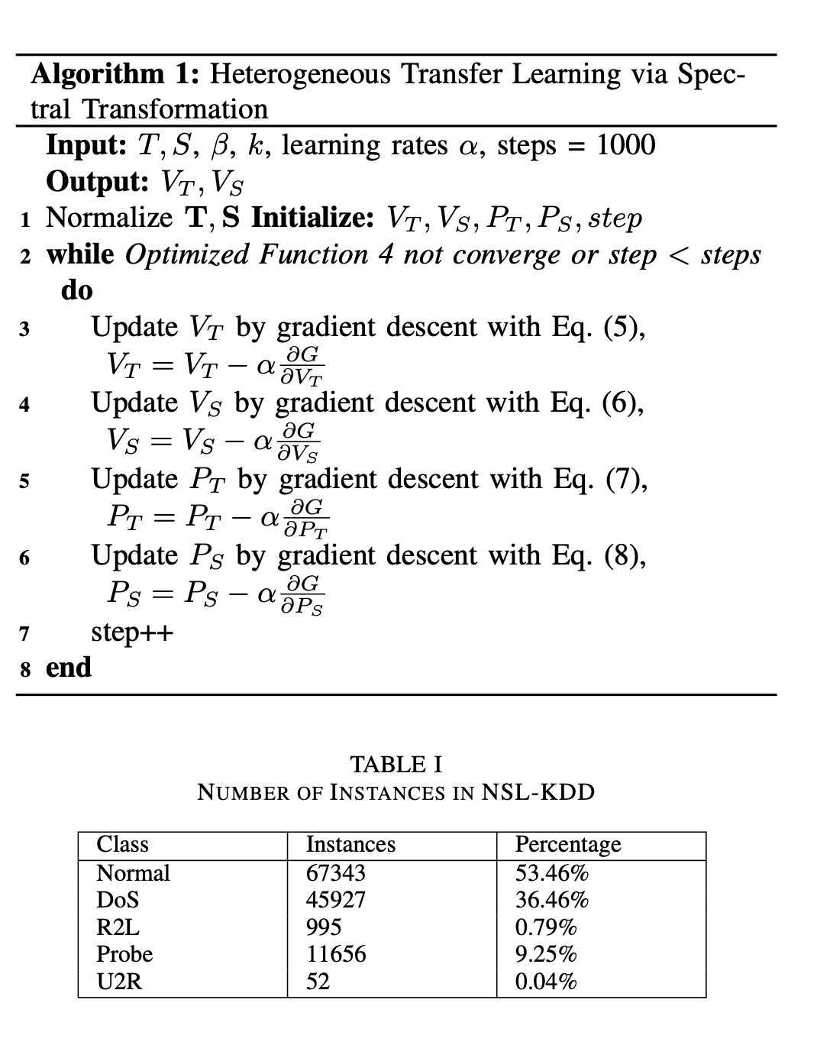
Algorithm and DataSet

Slide 19
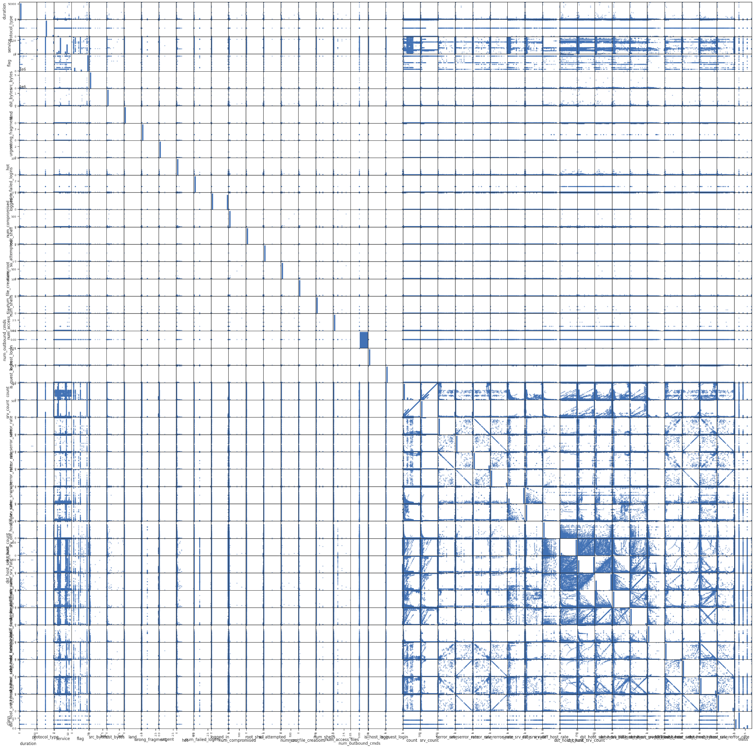
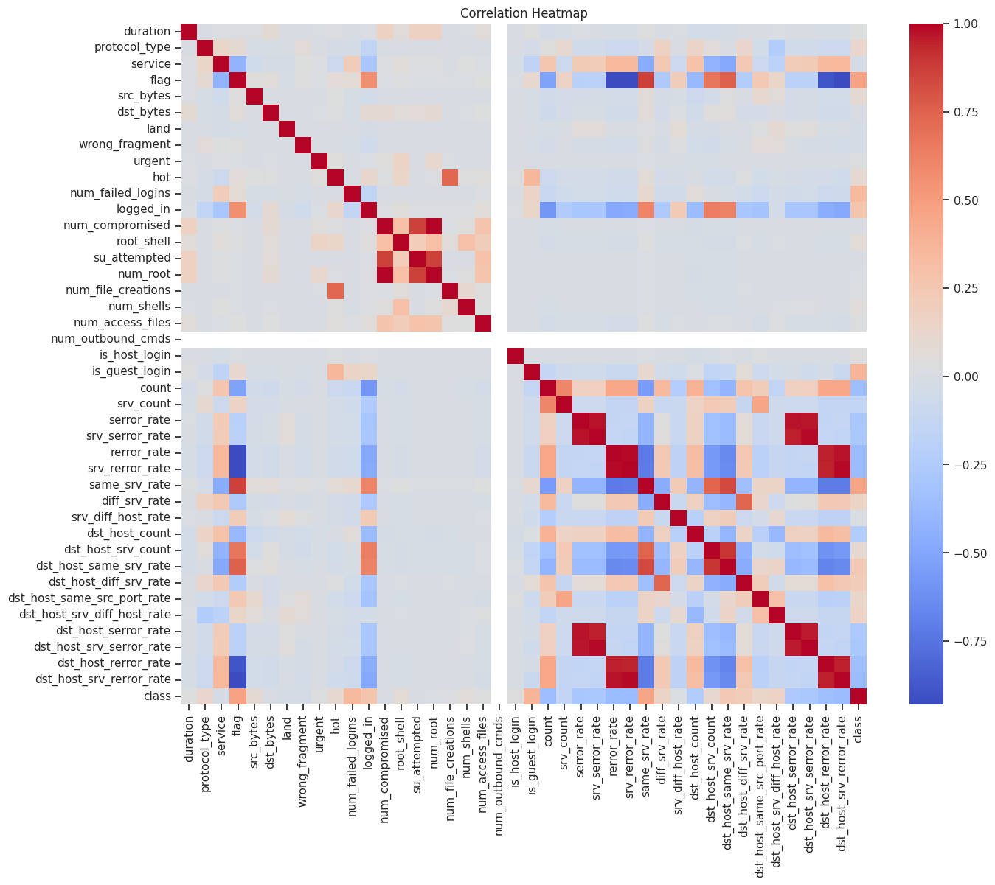
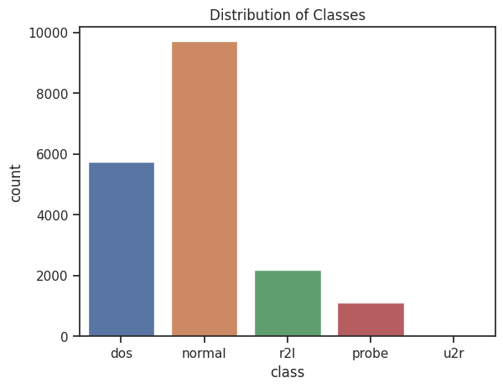
Data and Features

Slide 20
Experimental setting
Dataset Generation
To evaluate the transfer learning approach:
three datasets are created based on NSL-KDD. Each dataset consists of randomly selected normal examples and attacks from one class.
Transfer Learning vs Non-Transfer Learning
HeTL is evaluated against other feature-based transfer learning approaches, namely HeMap and CORrelation Alignment (CORAL), on network attack detection tasks.
The results show that HeTL significantly improves performance, with accuracy improvements of 35% - 50% and higher improvements in F1-scores.
The distribution of new feature representations further illustrates how HeTL improves performance by finding a subspace that makes the distributions of different attacks similar while still distinguishing them from normal behaviors.

Slide 21
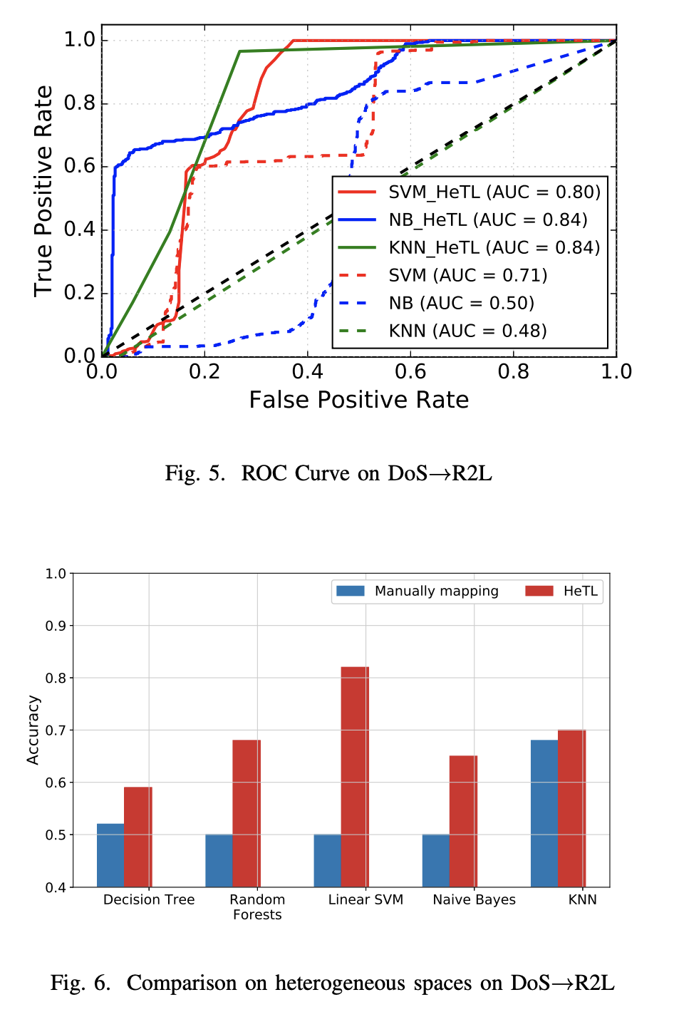
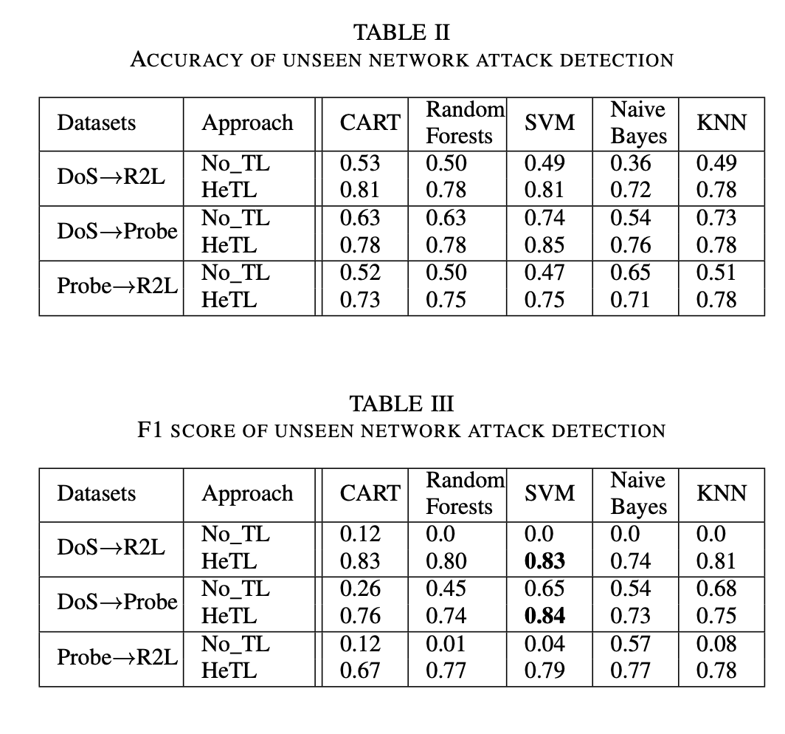
Results

Slide 22
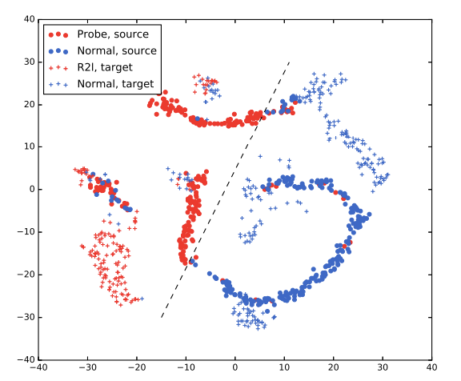
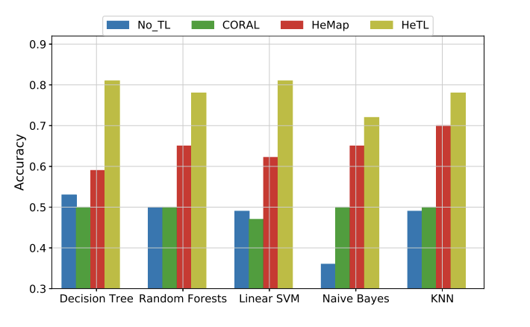
Results

Slide 23
Conclusion
Cyberattacks pose a significant threat to military and commercial networks
Intelligent anomaly detection techniques are essential
Transfer learning improves detection rates and adaptability
The proposed approach achieves better performance in detecting new attacks
Considerable contributions to the field of cyberattack detection.
visit colab to try the code and test the results:

Slide 24
Thank you for your time

